Slide 1

Fruity Fruits
Ready for the future of real ceREAL?
Ash & Khalid

Slide 2
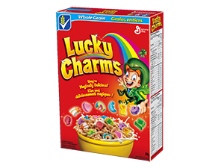
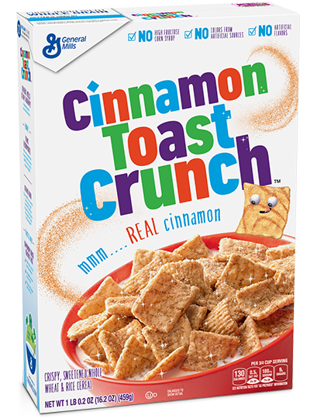
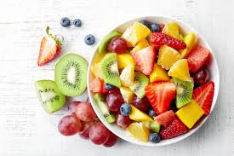
Our Product
Fruity nutritious cereal
Replaces added sugar
Healthy option for people that don’t want to eat fruits
All the best breakfast needs in one cereal
All the goodness of a fruit bowl in a cereal!
Sugary Badness

Slide 3


Primary:
Age – 5 to 17
Gender – All
Middle and Upper Class
Family size from 1-5
People in School
Secondary:
Age – 18 – 30
Gender – All
Middle and Upper Class
Family size from 1-5
Working People
Target Market

Slide 4
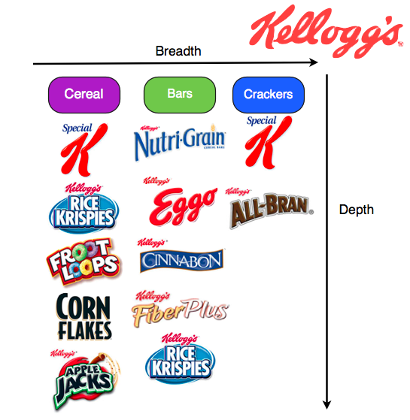
Where We Fit

Slide 5
Product Life Cycle
Development
Introduction
Growth
Maturity
Saturation
Extension
Decline

Slide 6

Marketing Mix
Product
Fruit shaped cereal that includes the same nutrition as the fruits they are based off of
$4.95
Average price for a Kellogg’s cereal is $3.95 but since we are using fruit nutrient in the Cereal the cost is more, so we have to increase the price in order to make a reasonable profit.
Price
Place
The Cereal will be sold at the top retail stores in Major cities along with surrounding suburbs.
Promotion
We will have our promotional team develop an Ad Campaign for the cereal.

Slide 7
SWOT Analysis
Strength | Weakness
Will receive same amount of fruit nutrition in your everyday breakfast Everything fruits offer just in a more fun way Provide a good calorie intake for boosting energy especially with Fruit nutrition in the Cereal Will offer a better supply of vitamins and minerals than any other cereal | Kellogg’s already produces many cereal brands. They already have a great grasp on the market that will take a bit of marketing magic and cereal innovation, that we have with our current idea, to break into.
The first cereal to implement all the nutrition fruit without added sugar No Competition | The cereal market is big, and a lot of people offer sugary cereals that people like and want to buy.
Opportunity | Threat

Slide 8
Features
1) Nutritional Value of fruits in an everyday food
2) No Added sugar only what’s in the fruits
3) No artificial flavors
4) Easy way to enjoy food you love while getting the breakfast fruit nutrition.

Slide 9
Benefits
1) Will receive same amount of fruit nutrition in your everyday breakfast
2) Everything fruits offer just without the fruit!
3) Provide a good calorie intake for boosting energy especially with Fruit nutrition in the Cereal
4) Will offer a better supply of vitamins and minerals than any other cereal

Slide 10
Thank you
The Best Cereal for the most nutrition!

